Slide 1




Garda Vetting
Approved ID Verifier Training

Slide 2
Welcome!
  How to Verify ID Documents & NVB forms
  Accepted forms of Photo ID
  Accepted forms of Proof of Address
  Vetting for under-18s
  ID Verification Form

Slide 3
Verifying Documents
  All documents must be seen in-person
  Applicant must produce original documents on day of verification
  Cannot accept photos, screenshots or scans of documents
  ID Verifiers take copies of ID and proof of address on the day of verification
  Proof of Address documents must be printed

Slide 4
Verifying Documents
All applicants need to bring each of the following:
1
2
3
NVB1 Form
Photo ID
Proof of Address

Slide 5
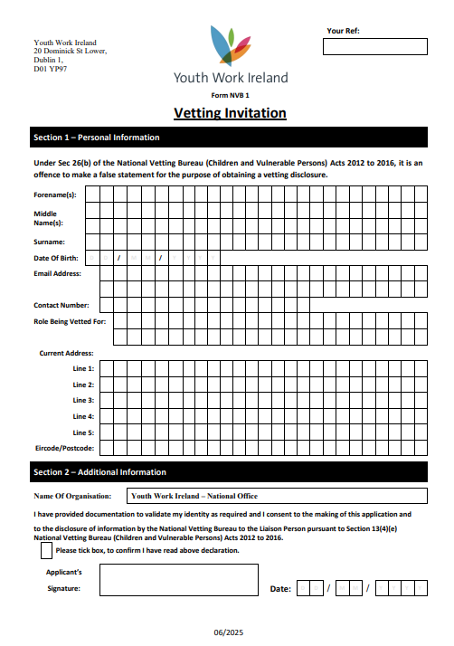
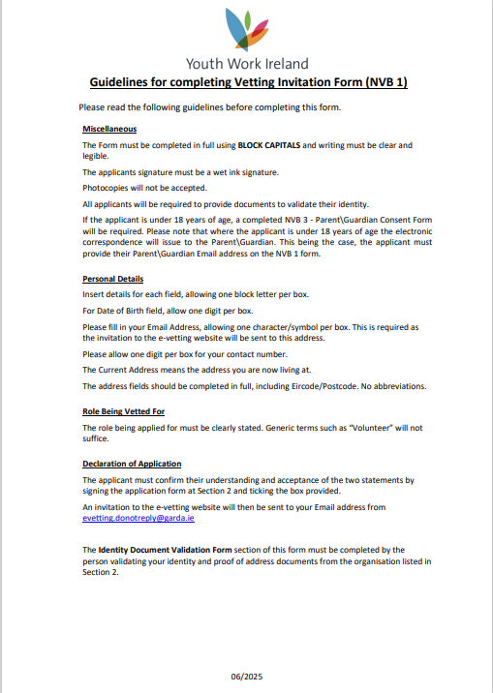
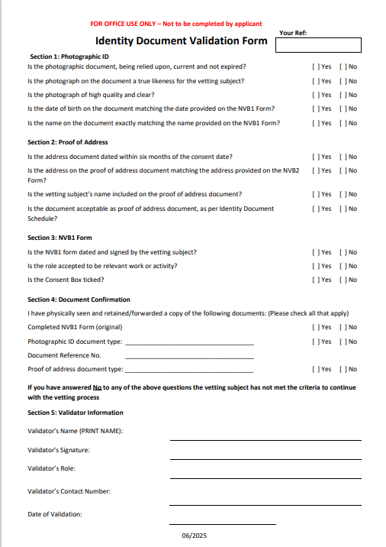
The NVB1 Form

Slide 6
Verifying an NVB1 Form
  Wet Signature
  Consent box ticked
  Date of consent
  Role Being Vetted For
  Organisation Name
  Matching Details

Slide 7
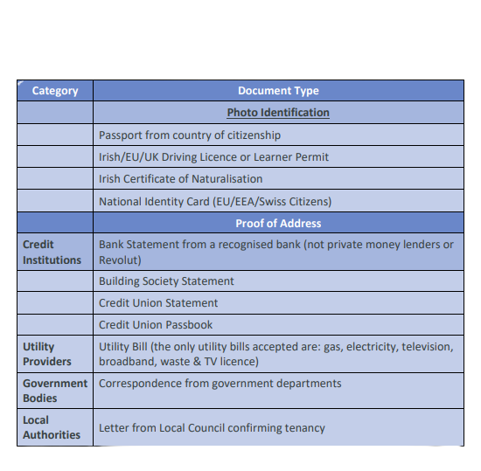
Acceptable Photo IDs
These are the only forms of photo ID we can accept

Slide 8
Verifying Photo ID
  Photo is clear & high quality
  Photo matches the person in front of you
  Document is valid & in-date
  Name on photo ID exactly matches name on NVB1 form
  Date of birth on photo ID exactly matches date of birth on NVB1 form

Slide 9
Acceptable Proof of Address
These are the only forms of proof of address we can accept

Slide 10
Additional Info
Cannot accept:
  Revolut Statements
  Mobile Phone Bills
  Letters from Government Agencies
    e.g. HSE, NDLS, Intreo
  Letters from Hotel or Direct Provision Centre Manager
    Must be from IPAS directly

Slide 11
Verifying Proof of Address
  Document has date clearly shown
  Date issued within 6 months of date of consent on NVB1 form
  Address is applicant’s current address
  Name on document exactly matches name on NVB1 form and Photo ID
  Address on document exactly matches address on NVB1 form

Slide 12
Vetting for Under 18s
  NVB will not process vetting for anyone under the age of 16
  All 16- and 17-year-old applicants must also have an NVB3 form
  NVB3 form is the Parent/Guardian consent form, and must include Parent/Guardian contact details

Slide 13
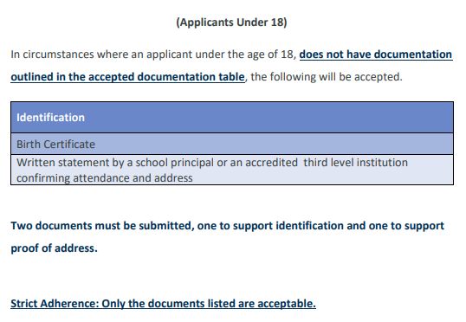
ID Verification for under-18s

Slide 14
Verification Form
  Only those who have completed this training may sign the verification form
  By signing the form, you are stating that you have carried out the relevant checks adequately and accurately
  There is an element of legal liability involved in this process
    See Section 26 & 27 of National Vetting Bureau (Children and Vulnerable Persons) Act 2012

Slide 15
What’s next?
I will send you the following:
  A copy of this presentation
  Various resources for easy access to this information
  Link to a quiz
Upon passing the quiz, you will receive a certificate and can begin verifying documents for vetting applicants!

